Slide 1

Everyday
TEAM NAME : Game Changer
SOUVIK MANDAL
NITISH KUMAR GUPTA
GAUTHAM CR

Slide 2

The problem
Fostering student motivation is a difficult but necessary aspect of teaching that instructors must consider. As most of the students may suffer from physical, mental, or other personal problems that affect motivation.
Not only students even most of the people around us often become tired of their daily life’s, this can impact in their work as they won’t be able to focus or give their 100%.
Students see little value in the course or its content, it is important to teach them with interesting facts and at the same time it is also necessary for the students to focus on logical problems.
There is also lack of knowledge about ongoing trends in technology which is very important in the current world.

Slide 3
The proposal
Our website’s main aim is to provide multiple features for the users, like it provides latest news on the popular topics for the users who want to have regular updates that are happening around the world. This website also provides motivational quotes for the users who are generally tired of their daily life.
This website also aims to provide facts on random topics to the users who like to gather information on various fields. The users can also make use of their free time by playing few logical games which we are providing in our website.
Thus our website provides various features where users of different types, such as some of them would be wanting some extra motivation to start their day, or some of the users may want to keep themselves updated by knowing the latest technologies, some of them would like to play puzzles or logical games. All these different kinds of users can get benefitted from our single website.

Slide 4
objectives
Latest news let the user stay updated.
Motivational quotes help in motivating the user.
Games and jokes give some recreation as well as improve their logical reasoning skills.
Facts on random topics helps the user to get some knowledge on various fields.

Slide 5
TECH stack
HTML
CSS
Bootstrap 4
JavaScript
Various APIs

Slide 6
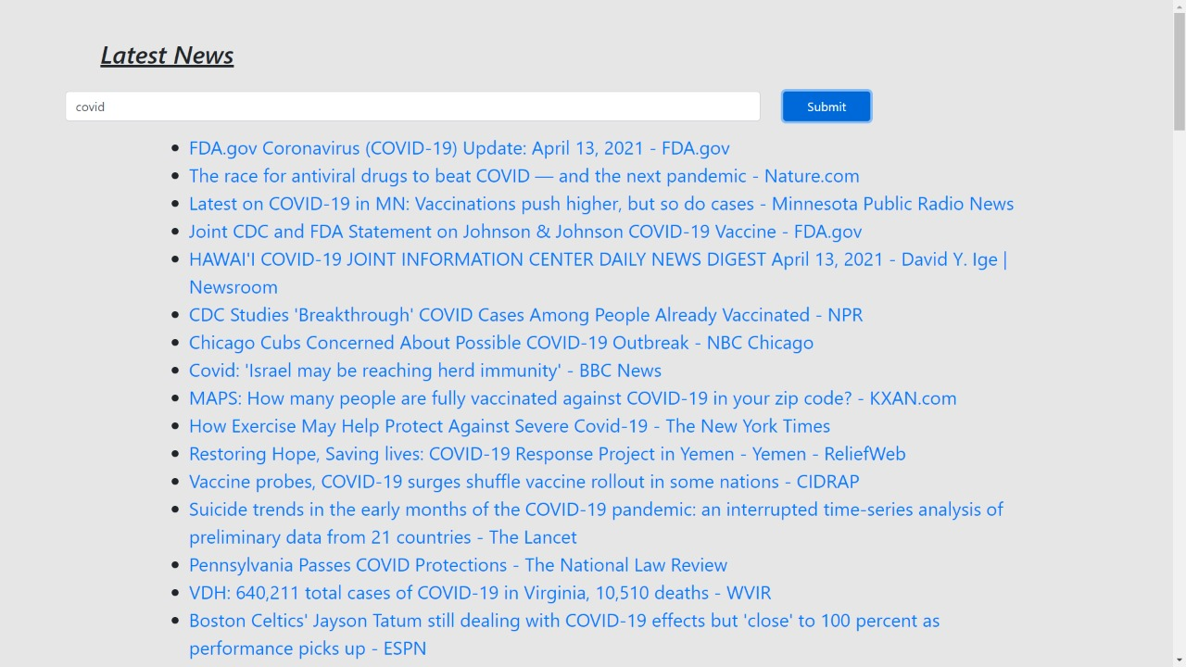
SCREENSHOTS
Following are some screen shots of our website :

Slide 7
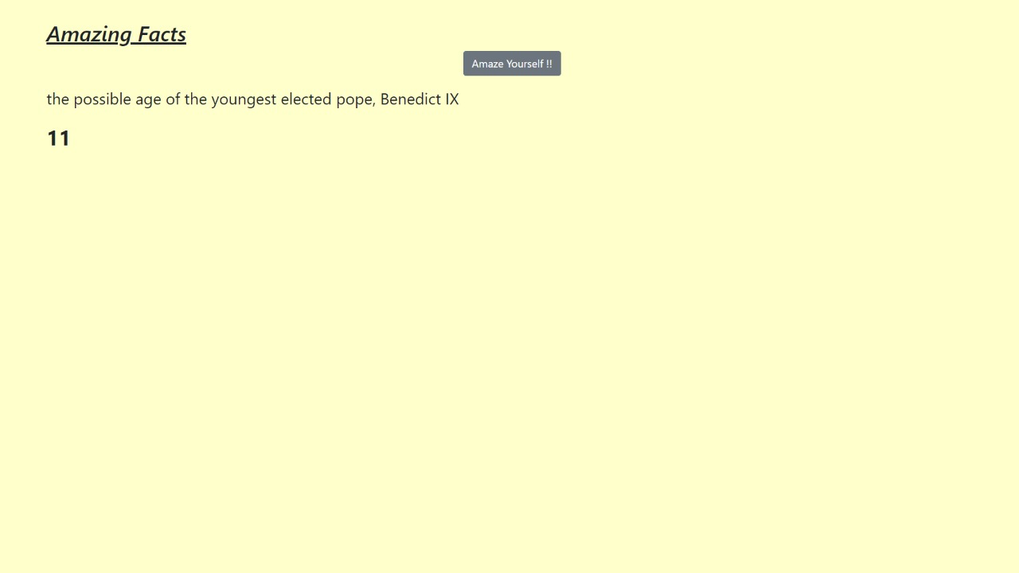

Slide 8
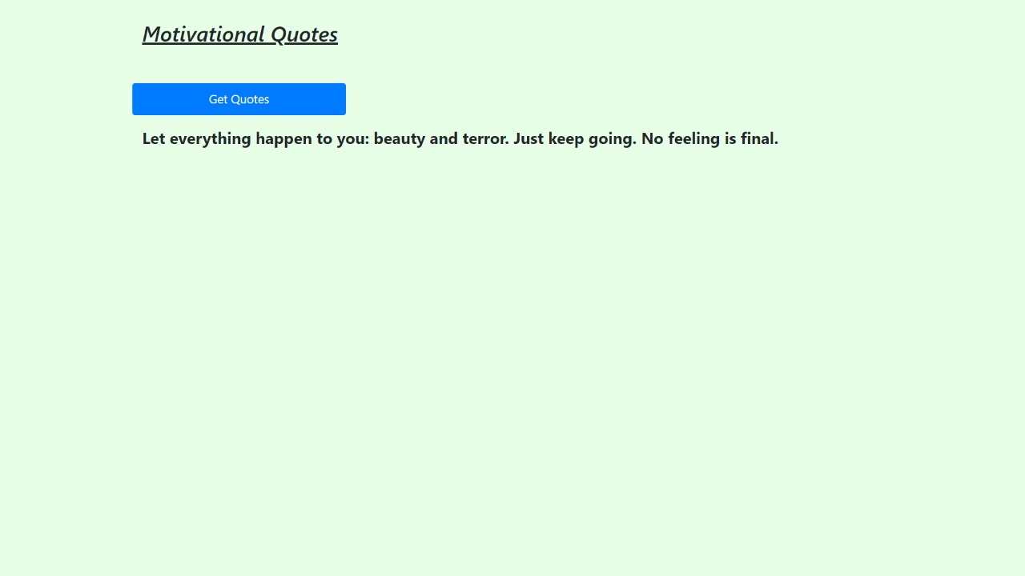

Slide 9
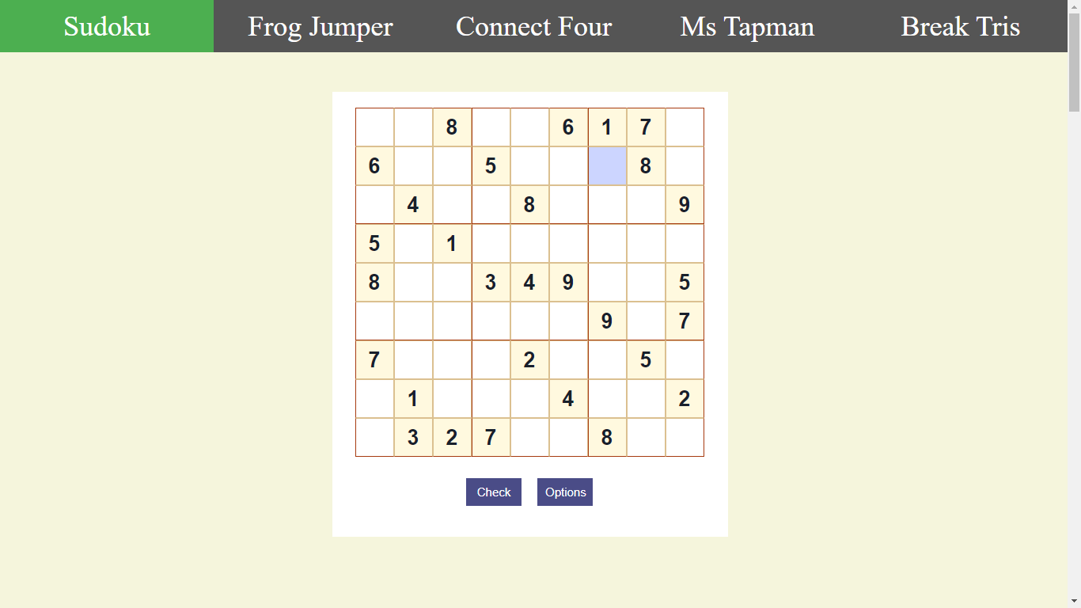

Slide 10
thank you!!

